Slide 1
SBAR Presentation
Notes:
Use this presentation to present to your hospital leadership; feel free to edit to fit your ED, hospital or organizational needs.

Slide 2
Agenda
Welcome and introductions
Situation
Background
Assessment
Recommendation
Conclusion
Notes:
Use this time to introduce yourself, provide your name, title, and experience.
Allow others in the meeting to introduce themselves

Slide 3
Situation
Notes:
I want to provide a brief description of a current problem we are experiencing here at [INSERT HOSPITAL NAME]. Discuss some background, provide my assessment and recommendation.

Slide 4
[Name of Hospital] Emergency Department
Current issues:
High turnover rate
Nurse burnout
Need for stronger clinical judgement for new ED nurses
Notes:
Here at [INSERT NAME OF HOSPITAL], emergency department, we are experiencing a high turnover rate among our emergency nurses.
It is currently at [insert turnover rate].
We are also seeing an increase in nurse burnout, and a desperate need for stronger clinical judgement in our newer nurses.

Slide 5
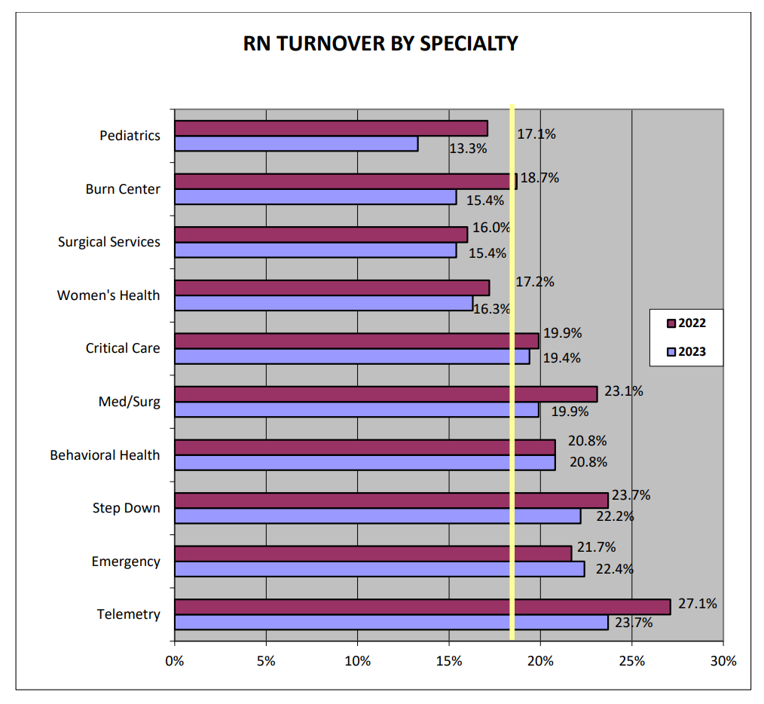
The Current State of Emergency Nursing
Nursing Solutions, Inc. (2024). NSI National Health Care Retention & RN Staffing Report. https://www.nsinursingsolutions.com/Documents/Library/NSI_National_Health_Care_Retention_Report.pdf
Notes:
Recruiting and retaining quality staff continues to be the primary concern for many emergency departments, and particularly ours.
According to the National Health Care Retention and RN Staffing Report, the average turnover cost for a bedside RN is $56,300, and that is for an average RN. When you start looking at specialty focused areas, like the ED or ICU, that number can increase as drastically, and even more so depending on where you live.
Here in {INSERT STATE], at our organization, the average turnover costs for an ED nurse is [INSERT $$$}.
Nationally, on average, emergency departments are seeing a turnover rate of 22.4%.
As I mentioned earlier, our turnover rate in the ED is [INSERT ED TURNOVER RATE].
Across the US, we have seen a 7.5% increase in turnover from last year and while which is costing hospitals millions, in fact, between $4-6 million a year.
This 7.5% is a significant increase and is estimated to continue to increase.
This trend has exacerbated the existing nursing shortage, making it increasingly challenging for healthcare facilities to maintain adequate staffing levels, quality patient care, and it’s costing a lot of money.
[ADD YOUR ED-SPECIFIC FACTS, WHAT HAVE YOU SEEN FROM PREVIOUS YEAR TO CURRENT REGARDING TURNOVER? MULTIPLE THAT BY THE COST OF HIRING AND ONBOARDING A NEW NURSE AND DEMONSTRATE THE DOLLARS LOST)
Reference:
Nursing Solutions, Inc. (2024). NSI National Health Care Retention & RN Staffing Report. https://www.nsinursingsolutions.com/Documents/Library/NSI_National_Health_Care_Retention_Report.pdf

Slide 6
Nursing Solutions, Inc. (2024). NSI National Health Care Retention & RN Staffing Report. https://www.nsinursingsolutions.com/Documents/Library/NSI_National_Health_Care_Retention_Report.pdf
Notes:
The most vulnerable are our new nurses. Nurses with 1-2 years of tenure.
According to the Nursing solutions data, nearly a third of all new hires left within a year. [can expand on what you are seeing at your hospital and compare]
There is something that happens in those first 1-2 years of a nurse’s career causing such high turnover.
References:
Barbarotta, L. (2021). Understanding and mitigating nurse turnover in emergency departments. Journal of Emergency Nursing, 47(1), 45-50. doi:10.1016/j.jen.2020.10.006
Hunt, S. T. (2020). The relationship between nursing turnover and quality of care: A literature review. International Journal of Nursing Studies, 102(1), 103469. doi:10.1016/j.ijnurstu.2020.103469
Nursing Solutions, Inc. (2024). NSI National Health Care Retention & RN Staffing Report. https://www.nsinursingsolutions.com/Documents/Library/NSI_National_Health_Care_Retention_Report.pdf

Slide 7
Reasons for Leaving the ED
High-stress environment
Long and unpredictable hours
Lack of support
Workplace culture
Leadership
Limited professional development
Compensation and benefits
Safety concerns
Job dissatisfaction, moral distress
Notes:
Emergency nurses often leave their jobs for other emergency departments (EDs), sometimes for new nursing opportunities outside of the ED, or leave nursing all together.
The reasons for leaving the ED vary but based on current literature, here are the top reasons nurses leave the ED. (Review)
In our ED, nurses have indicated they left because [Cite the reasons why nurses have recently left your ED]
References:
Al-Ghabeesh, S. H., & Qattom, H. (2019). Workplace bullying and its preventive measures and productivity among emergency department nurses. BMC health services research, 19(1), 445. https://doi.org/10.1186/s12913-019-4268-x
Boulton, O., & Farquharson, B. (2023). Does moral distress in emergency department nurses contribute to intentions to leave their post, specialisation, or profession: A systematic review. International journal of nursing studies advances, 6, 100164. https://doi.org/10.1016/j.ijnsa.2023.100164
Li, Y. F., Chao, M., & Shih, C. T. (2018). Nurses' intention to resign and avoidance of emergency department violence: A moderated mediation model. International emergency nursing, 39, 55–61. https://doi.org/10.1016/j.ienj.2017.09.004
McIntyre, N., Crilly, J., & Elder, E. (2024). Factors that contribute to turnover and retention amongst emergency department nurses: A scoping review. International emergency nursing, 74, 101437. https://doi.org/10.1016/j.ienj.2024.101437
Norful, A. A., Cato, K., Chang, B. P., Amberson, T., & Castner, J. (2023). Emergency Nursing Workforce, Burnout, and Job Turnover in the United States: A National Sample Survey Analysis. Journal of emergency nursing, 49(4), 574–585. https://doi.org/10.1016/j.jen.2022.12.014
Rozo, J. A., Olson, D. M., Thu, H. S., & Stutzman, S. E. (2017). Situational Factors Associated With Burnout Among Emergency Department Nurses. Workplace health & safety, 65(6), 262–265. https://doi.org/10.1177/2165079917705669
Stafford, S., Avsar, P., Nugent, L., O'Connor, T., Moore, Z., Patton, D., & Watson, C. (2022). What is the impact of patient violence in the emergency department on emergency nurses' intention to leave?. Journal of nursing management, 30(6), 1852–1860. https://doi.org/10.1111/jonm.13728

Slide 8
Impact of ED Nurse Turnover
Nursing shortage
Increase workload
Increase stress
Moral distress
Disruption of workflow
Diminishes quality of nursing care
Decreased productivity
Getty Images: 1453799571
Notes:
But it’s not just the organization that loses. What happens in the department? What happens to nurses that stay? More shifts, maybe longer shifts, to cover gaps. And what do we know of those effects? Heightened stress and fatigue, moral distress, burnout. And all that leads to poor physical and emotional well-being.
Staffing shortages increases the workload for those who remain, it increases the stress, it impacts morale, disrupts workflows, diminishes nursing care and not only the quality of care, but productivity as well. It’s disruptive to everyone.
References:
Barbarotta, L. (2021). Understanding and mitigating nurse turnover in emergency departments. Journal of Emergency Nursing, 47(1), 45-50. doi:10.1016/j.jen.2020.10.006
Hunt, S. T. (2020). The relationship between nursing turnover and quality of care: A literature review. International Journal of Nursing Studies, 102(1), 103469. doi:10.1016/j.ijnurstu.2020.103469
Nursing Solutions, Inc. (2024). NSI National Health Care Retention & RN Staffing Report. https://www.nsinursingsolutions.com/Documents/Library/NSI_National_Health_Care_Retention_Report.pdf
Sillero, A., & Zabalegui, A. (2022). The impact of nurse turnover on patient care and nursing work environment. Nursing Management, 29(2), 22-28. doi:10.7748/nm.2022.e1983
Smith, J. & Jones, L. (2020). The effects of turnover on emergency department nurses' job satisfaction and patient care quality. Nursing Research, 69(4), 276-282. doi:10.1097/NNR.0000000000000421

Slide 9
Investment in Education
ED nurses will remain in their positions for less money IF they receive substantial support in continuing education and professional development
Continuing education:
Enhances competency
Increases job satisfaction
Improve patient care
Fosters professional development
Encourages retention
Notes:
Research supports the notion that emergency nurses are willing to remain in their positions for lower pay if they receive substantial support in continuing education and professional development. Several studies and articles highlight that ongoing education and professional development opportunities not only enhance job satisfaction but also improve retention rates among nurses. This is because such opportunities allow them to stay current with medical advancements, thereby increasing their competence and satisfaction levels in their roles.
One study highlighted that continuous professional development is crucial for nurses throughout their careers. It helps in maintaining competency, providing quality patient care, and fostering career advancement opportunities. This kind of environment encourages retention by making nurses feel valued and supported, which can compensate for less competitive financial compensation
Continuing professional development (CPD) helps nurses stay current in their skills, enhances job satisfaction, and encourages retention.
Nurses highly value opportunities for ongoing learning, which contributes to career growth and improves their sense of professional fulfillment.
Investing in education can thus offset financial compensation as a primary reason for staying in a role​
Retaining experienced emergency and critical care nurses is crucial for ensuring consistent, high-quality patient care, as their specialized expertise is vital to these demanding practice environments.
References:
Mlambo, M., Silén, C., & McGrath, C. (2021). Lifelong learning and nurses' continuing professional development, a metasynthesis of the literature. BMC nursing, 20(1), 62. https://doi.org/10.1186/s12912-021-00579-2
Price, S., & Reichert, C. "The Importance of Continuing Professional Development to Career Satisfaction and Patient Care: Meeting the Needs of Novice to Mid- to Late-Career Nurses throughout Their Career Span." Administrative Sciences 7, no. 2 (2017): 17. https://doi.org/10.3390/admsci7020017.
Van Osch, M., Scarborough, K., Crowe, S., Wolff, A. C., & Reimer-Kirkham, S. (2018). Understanding the factors which promote registered nurses' intent to stay in emergency and critical care areas. Journal of clinical nursing, 27(5-6), 1209–1215. https://doi.org/10.1111/jocn.14167

Slide 10
Background
Notes:
Use this slide to discuss the time you took to research, or how you stumbled upon ENA’s ENRP.

Slide 11
Founded in 1970
Premier professional association of emergency nursing
Global leader in standards for emergency care, education, research, & advocacy
Work to improve patient care, staff safety, and professional growth
Widely recognized for evidenced-based practice, research, and education
Focus Areas
Education and verification
Advocacy
Research and innovation
Notes:
Founded in 1970, the Emergency Nurses Association (ENA) is the premier professional association dedicated to advancing excellence in emergency nursing.
With over 50 years of experience, ENA is a global leader in setting the standards for emergency care, offering cutting-edge education, research, and advocacy.
ENA represents more than 50,000 emergency nurses worldwide, working to improve patient care and safety while supporting the professional growth of emergency nursing staff.
ENA is widely recognized for its commitment to evidence-based practice, research-driven guidelines, and developing educational programs that empower emergency nurses to deliver high-quality, safe, and effective care in the most challenging environments.
The organization provides a platform for emergency nurses to network, collaborate, and lead advancements in emergency healthcare across diverse settings, from urban trauma centers to rural emergency departments.

Slide 12
Nurse Residency Programs
Provide supporting environment
Smoother transition
Cost savings
Fosters professional development
Creates a culture of continuous learning
Builds more competent workforce
Improves satisfaction
Creates a desirable place to work
Notes:
There is no doubt that nurse residency programs offer substantial benefits. Well-structured and planned residencies provide newly graduated nurses with a supportive transition from academic environments to clinical practice. They also provide new nurses with a better understanding of the ED environment in a more scaffolded way.
Additionally, residency programs enhance the overall quality of patient care, as they equip new nurses with the skills and confidence to perform effectively.
By fostering professional development and encouraging a culture of continuous learning, nurse residency programs also help to build a more competent and dedicated nursing workforce, which can improve patient outcomes and satisfaction. It also helps to re-energize existing staff. The eagerness and enthusiasm new nurses bring is infectious.
Hospitals with well-structured residency programs often enjoy a stronger reputation as desirable employers, attracting top talent in a competitive market.
But there are some challenges, the first being, residency programs are extremely time consuming to development and maintain.
References:
Ackerson, K., & Stiles, K. A. (2018). Value of Nurse Residency Programs in Retaining New Graduate Nurses and Their Potential Effect on the Nursing Shortage. Journal of continuing education in nursing, 49(6), 282–288. https://doi.org/10.3928/00220124-20180517-09
Cochran C. (2017). Effectiveness and Best Practice Of Nurse Residency Programs: A Literature Review. Medsurg nursing : official journal of the Academy of Medical-Surgical Nurses, 26(1), 53–63.
Eckerson C. M. (2018). The impact of nurse residency programs in the United States on improving retention and satisfaction of new nurse hires: An evidence-based literature review. Nurse education today, 71, 84–90. https://doi.org/10.1016/j.nedt.2018.09.003
Han, P., Duan, X., Wang, L., Zhu, X., & Jiang, J. (2022). Stress and coping experience in Nurse Residency Programs for new graduate nurses: A qualitative meta-synthesis. Frontiers in public health, 10, 979626. https://doi.org/10.3389/fpubh.2022.979626
Knighten M. L. (2022). New Nurse Residency Programs: Benefits and Return on Investment. Nursing administration quarterly, 46(2), 185–190. https://doi.org/10.1097/NAQ.0000000000000522
Miller, C. M., Meyer, K., Riemann, L. A., Carter, B. T., & Brant, J. M. (2023). Transition Into Practice: Outcomes of a Nurse Residency Program. Journal of continuing education in nursing, 54(1), 32–39. https://doi.org/10.3928/00220124-20221207-08
Van Camp, J., & Chappy, S. (2017). The Effectiveness of Nurse Residency Programs on Retention: A Systematic Review. AORN journal, 106(2), 128–144. https://doi.org/10.1016/j.aorn.2017.06.003
Wildermuth, M. M., Weltin, A., & Simmons, A. (2020). Transition experiences of nurses as students and new graduate nurses in a collaborative nurse residency program. Journal of professional nursing : official journal of the American Association of Colleges of Nursing, 36(1), 69–75. https://doi.org/10.1016/j.profnurs.2019.06.006

Slide 13
ENA Emergency Nurse Residency Program
Purpose:
The ENA Residency Program is focused on building decision-making skills, improving clinical judgement, reducing burnout and improving turnover
The ENA Residency Program
Trains preceptors
Fosters collaboration
Establishes effective communication
Notes:
Recognizing this, the ENA develop an emergency nurse residency program with the goal of creating a standardizing new graduate and transitional nursing onboarding.
Emergency Nurse Residency Program (ENRP) is a comprehensive, structured educational program designed to bridge the gap between nursing school and real-world emergency nursing practice.
Tailored specifically for new graduate nurses or nurses transitioning to emergency care, ENRP ensures that participants build critical thinking, clinical judgment, and specialized skills necessary for the high-pressure and fast-paced environment of the emergency department (ED).
ENRP emphasizes the development of critical emergency nursing skills, including clinical decision-making, patient assessment, safety protocols, and collaborative team-based care.
Reference:
Emergency Nurses Association. (2024). Emergency Nurse Residency Program (ENRP). www.ena.org/enrp

Slide 14
ENRP Components
Independent Learning Modules
Observation & Hands On
Classroom Case Studies
Classroom Didactic
Skills & Equipment
Coaching Sessions
Preceptor
Reflection Sessions
ENRP Workbooks
Simulation
Creative #: 1448558524
Notes:
There are several components to the residency program, which you can see here. In addition to providing a robust learning experience for the new grad or new to the ED nurse, ENA also provides tailored schedules to meet our needs and a roadmap of the various ways to integrate the program into our hospital’s emergency department.

Slide 15
Program Support
Individualized program support
Tailored onboarding
Assisted program establishment
Guided organization
Troubleshooting
Direct-contact
residency@ena.org
Notes:
They offer individualized program support with a dedicated, experienced emergency nurse, as support.
ENA will collaborate with us to perform an environmental scan of our current nurse onboarding, offer creative solutions, and help tailor the program to meet our needs
They will continue to guide us, assist with any troubleshooting, and provide continued support during the length of our subscription.

Slide 16
ENRP Subscription Model
1–3-year subscription options
Unlimited access to ENRP
Cost is based on ED visits
ENA offers discount for 3-year subscription
Onsite onboarding for hospitals with 3-year terms
Notes:
The program is based on a subscription model. Hospitals can purchase a 1-to-3-year subscription to the ENA’s residency program. The program is unlimited, meaning, we can put through as many nurses as we’d like through the program, it’s not based on per seat or per student. Rather we pay according to our subscription term. We will have unlimited access to all of the educational material and the cost is based on annual ED visits. ENA does offer discounts for longer-term subscription for 3 threes.
Depending on the term of our subscription, ENA also offer onsite onboarding of our educators for hospitals that have a 3-year subscription. Which means, ENA will come here to our hospital, walk us through the program, and essentially train the trainer. While they are here, there is an opportunity for ENA to facilitate a preceptor workshop.

Slide 17
Preceptor Workshop
Live, in-person workshop
Topics discussed
Roles and responsibilities
Identifying learning gaps
Communication techniques
Feedback techniques
Practice communication
Role playing
Notes:
ENA’s preceptor workshop is a 4-hour live, in-person workshop delivered by ENA nurses that teach Precepting.
They go over roles and responsibilities of a preceptor, how to identify learning gaps, they teach different communication techniques include providing constructive criticism, and there are multiple practice scenarios for communication and role playing.
The workshop has been delivered to all different types of nurses, not just ED nurses, and it’s also been taught across different health disciplines, like patient care technicians, who have benefitted from the workshop.
If we’re interested, we can reach out to ENA for more information.
For hospitals that subscribe to a 3-year term, ENA provides 1 preceptor workshop.

Slide 18
What’s Included in ENA’s ENRP
15 Didactic education topics with
Agendas
Lecture slides
Instructor notes
Instructor tips
Over 30 classroom case studies
Lecture slides
Instructor notes
Instructor tips
17 Simulation scenarios
Self-paced learning modules
Resident workbook
Notes:
ENA provides 15 didactic educational topics which include agendas, lecture slides, instructor notes, and instructor tips. The content is housed in ENA's learning management system which can be easily accessed via the Internet. Included in the agendas are recommended equipment lists and common policies and procedures.
There are over 30 classroom case studies that also include slides decks, instructor notes and instructor tips to help guide educators on learner engagement and reminders of integration of documentation and learner engagement.
ENA provides 17 simulation scenarios that can be done either table top, low fidelity or high-fidelity in a simulation lab.
Each resident that we put through our program also receives self-paced learning modules created and developed by ENA.
Also, each resident will receive a workbook to help supplement their learning throughout the program.

Slide 19
Supporting the Resident
Coaching sessions
Mentorship through hospital coaches
Provide additional support outside of the program
Help to introduce resident to the organization
Reflection sessions
Debriefing
Critical thinking
Building confidence and coping skills
Promoting healthy work environment
ENA Membership
Residents receive a 1-year ENA membership
Notes:
As part of ENA’s mission and values, ENA is a strong advocate for healthy work environments and strives to bring more attention to this topic. As part of their initiatives, they also include a structured framework for mentorship through the role coaches.
Reflection sessions are another opportunity to debrief review cases in a supportive and safe environment, and help build confidence and coping skills. Reflection sessions are guided discussions that help guide residents in developing critical thinking while learning from others, all in the effort to help promote a healthy work environment.

Slide 20
ENRP Results
Notes:
There are many tangible benefits of partnering with ENA and obtaining their emergency nurse residency program. First let’s take a look at the value proposition

Slide 21
ENRP Competency Results
Obtaining a Patient History:
High Confidence (Levels 8-10): A majority of nurses (87.77%) rated themselves between 8-10 on the confidence scale, indicating strong confidence in obtaining a patient history. This demonstrates that the vast majority feel capable and comfortable in this critical aspect of patient care.
Identifying Red Flags: High Confidence (Levels 8-10): A significant portion of nurses (80%) of the nurses rated themselves between 8-10 in their ability to identify red flags, indicating that the majority feel highly confident in recognizing potential warning signs during patient care. This high level of confidence suggests that most emergency nurses possess the critical skills necessary to recognize early warning signs, which is vital for patient safety and timely interventions. This is crucial in emergency settings where swift identification of red flags can improve patient outcomes.
Performing a Patient Assessment: High Confidence (Levels 8-10): A significant majority of nurses (89.1%) rated themselves between 8 and 10, indicating a strong confidence in performing patient assessments. This high level of confidence is critical for ensuring effective patient care in emergency settings, where prompt and accurate assessments can influence outcomes.
Initiating Interventions Independently: High Confidence (Levels 8-10): The majority of respondents (86.63%) rate their confidence between 8 and 10, showing a strong sense of competence in independently initiating patient interventions.
Notes:
The following data is specifically examining emergency nurse residents after 18 weeks of ENRP residency. What is significant about this data is that after only 18 weeks, a good majority of residents participating in the program feel confident in their ability to obtain a patient history, identify red flags, perform a patient assessment and independently initiate interventions.
The data shows that the ENRP builds confident, competent nurses who can deliver excellent emergency care, improving patient outcomes and operational efficiency. For hospitals, purchasing this program would not only develop a skilled workforce but also support long-term goals such as staff retention, better patient care, and maintaining a strong reputation.
n=188, 10% response rate 34 EDs

Slide 22
ENRP Resident Confidence Level
As of today, I am confident that I am able to: | Pre-ENRP Confidence Level* | Post ENRP Confidence Level**
Obtain a history from the patient | 7 | 9
Identify red flags | 7 | 8
Perform an assessment on the patient | 7 | 9
Initiate interventions on the patient | 6 | 8
Anticipate diagnostic testing the patient may need | 6 | 8
Perform a reassessment on the patient | 7 | 9
Communicate effectively with the patient, other clinicians, etc. | 7 | 9
*Not confident at all (0) – Completely Confident (10); N=275 **Post ENRP Confidence Level- N=73
ENA Emergency Nurse Residency Program. (2024). Current Hospital Data. https://www.ena.org/enau/residency-program
Notes:
What you’re looking at here is the residents’ reported confidence levels. So, we measure their confidence pre-residency then post completion of the program.
These are results we would expect to see. They are feeling more confident getting a patient history, they still need help identifying red flags, and that’s completely normal, but we do see an increase in their confidence. This is great news.
They also do feel stronger about initiating interventions, anticipating diagnostic tests, and performing assessments.
Getting anyone to complete surveys is tough as I am sure many of you know. Once the nurses are out on their own on the floor, it’s hard to get them to complete our survey and submit data. But we’ve created some solutions to help so we’re hoping this coming year, we’ll have more results to share.

Slide 23
Notes:
This slide shows a random sample of 9 of the 76 emergency departments running ENRP in the U.S. What is significant to note are the overall retention numbers. Of note-hospital 6; the program was not facilitated by an ED educator but rather by a non-ED nurse. More analysis would need to be conducted to draw any type of correlation or impact his had with ED retention.

Slide 24
Resident Feedback
“I can see how much I have learned during the residency. I feel like my critical thinking skills have evolved. I feel more confident with patient care and interdisciplinary conversations with the care team. I am excited to apply what I have learned during these 18 weeks to my future patient care scenarios here in the ED.”
“I feel as if I have grown into a better skillful critically thinking nurse thanks to this ED residency. I believe that I have become better at asking for help and asking questions no matter how ridiculous or stupid they sound. I have gained more confidence in my skills and time management. I have been better at prioritizing my patients and tasks that need to be completed. Overall, I have grown significantly in areas that I didn't expect.”
“At the beginning of this, I was so overwhelmed. Now, I have much more confidence as a nurse, feel a lot better about the care I give, and my skills have improved immensely. I enjoy being able to apply the knowledge that I have learned or see some of the issues firsthand.”
“I believe I have been able to develop into a safe and confident nurse through my residency program. My time management has improved to that of what is required to withstand the flow of a busy emergency department, and I am comfortable utilizing my resources and seeking help from my colleagues when necessary.”

Slide 25
ENRP Case Studies
Notes:
Here is a look a some of the ENRP current clients.

Slide 26
Clovis Community Medical Center
Located in central California
352 private rooms
48 licensed ED beds
63,480 ED visits (1/24-5/24)
Notes:
Clovis Community Medical Center located in Central California. 352 private rooms, 48 licensed ED beds (which doesn’t include hall beds or SCU)​
In May of this year, Clovis saw around 7600 patients the ED, which is increasing monthly, daily average 247 (based on May 2024)​
# of ED visits annually: 2021 – 59,644, 2022 – 70,965, 2023 – 80,461 and fiscal YTD thru May 63,480​
They are on track to see over 85,000 this fiscal year
Community hospital that is growing and continue to see a record number of patients. ​
With that, border hours have also increased.

Slide 27
Clovis Community Medical Center
Overall retention rate (all staff)
FY22: 77.8%​
FY23: 62.3%​
FY24: 78.3%
Retention Rate for Employees in their first year:
FY22: 56%​
FY23: 65%​
FY24: 50%
Notes:
The overall retention rate for the ED is listed ( FY22 77.8%, FY 23 was 62.3% and FY24 is 78.3%)
Retention rate – 50% for FY24, which means a 50% turnover rate for our first year nurses.

Slide 28
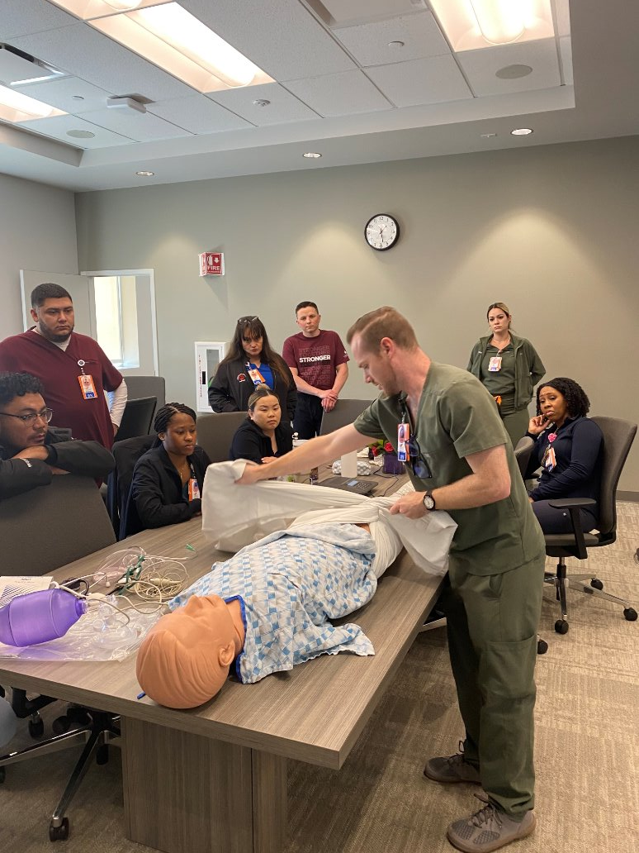
Clovis Community Medical Center: First ENRP Cohort Retention
13 residents
1 left due to moving out of state
12 completed the program
92% Retention rate
3 months post residency
Still early
Will continue to monitor
0%-Intend to leave within the next 6 months
Notes:
Clovis had 13 residents in their first cohort; 1 left due to family moving out of state and was unpreventable
12 completed the program (18 weeks)
Before ENRP, the average 1st year turnover rate as high as 31%.
The retention rate post ENRP is up to 92%. This is 3 months post residency. This is still early data and Clovis will continue to monitor but residents were surveyed and 0% intend to leave within the next 6 months.
What is also significant, is the feedback and observations from others in the organization

Slide 29
“In my opinion just watching them side by side of the previous new grads they are far more better prepared for their first independent shift. Not only do they seem more confident, they are way more connected with other team members. Almost like the whole department has taken them in and watches over them. It is an entire department shift on taking care of those that are new. The opposite of eating our young.” Marilyn Greene, MSN ED Director
“I have absolutely, wholeheartedly enjoyed being coach for this cohort. It reminded me of my days as a preceptor, which is one of the aspects I miss most about bedside nursing. My ENRP resident, Ashley, has brought me immense joy throughout this process. I very much enjoyed watching her grow throughout the cohort as well as getting to know her as a young professional. The concept of weekly topics provided a solid framework to build on, and I appreciated the flexibility to explore wherever the conversations led us.”
Ryan Taylor, BSN, RN
Director Inpatient Cardiovascular Svc
There has been a positive culture shift within the department in relation to the new grad resident program, one staff nurse observed.
A quote from a resident – “The additional resources recommended to me for communication and learning how to get more confident in my nursing skills have really helped me and I have shared some of the with the other in my group”
“Being able to hear and see our current nursing environment through the ears and eyes of a new grad have created great self-reflection for my “why” of advocating for patients and staff. My passion is reignited to help those who will care for me one day.” Joyce Eden, RN, MHA, MSN CHS Stroke Supervisor
Notes:
Staff feedback about program
Clovis had such incredible feedback from the coaches. They too felt they received benefit from being a part of the program

Slide 30
Clovis Community Medical Center
Notes:
Involved marketing to assist with this.
Community Health Systems has a show on local network tv called MedWatch.
The ED director reached out them to do a story on the residency program. It aired during nurses week.
Recruitment was involved as well.
Clovis posted systems job board, the posting for the new grad residency program has the video imbedded. At job fairs and student career fair I am there to promote with flyers and a banner.

Slide 31
Huntsville Hospital
881-bed hospital
Second largest in state of Alabama
State’s largest emergency and trauma program
Alabama’s only Level I trauma center
160,364 annual ED visits
Notes:
Huntsville Hospital is an 881-bed hospital that serves as the regional referral center for North Alabama and southern Tennessee.
As the second-largest hospital in Alabama, Huntsville Hospital is governed by the Health Care Authority of the City of Huntsville.
In recent years, the hospital has grown its services throughout the region with the development of Huntsville Hospital Health System. This growth includes hospitals in Huntsville, Madison, Athens, Decatur, Boaz, Guntersville, Moulton, Red Bay, Sheffield and Scottsboro, Alabama.
Within this health system, there are more than 2,300 patient beds and 16,000 employees.

Slide 32
Huntsville Hospital Cohorts
Successfully ran 6 cohorts
Currently on 7th cohort
Total of 32 new graduates onboarded since 11/22
Has maintained over 90% retention rate for 2 years

Slide 33
ENRP Proven Results
First hospital in ENRP
ENRP helped to decrease orientation time
Improved critical thinking
Improved new nurse retention
Over 90% retention rate
Increase acuity of patients managed

Slide 34
Huntsville Hospital Resident Feedback
Reflection on Anxiety and Growth
"I have learned that it’s okay to ask questions and not know everything. It’s okay to ask for help. It’s okay to question why we are doing something, and it’s okay to be a baby new nurse, as long as I continue to learn."
Significant Confidence Improvement
"There were a lot of confidence issues that I overcame, and I feel incredibly confident in my skills and thought processes as a clinical nurse."
Clinical Decision-Making and Confidence in Crisis
"This patient went unresponsive in front of my eyes, and I was able to recognize this change immediately, check for a pulse, and start chest compressions... I feel better prepared now for changes in my patient’s status and how to react calmly to these changes."
Deeper Understanding of Clinical Concepts
"This program helped me break down the why and how of common clinical presentations and think past what’s directly in front of me. I liked the part where it would ask for differential diagnoses to remind us not to keep a one-track mind."
Notes:
These four comments capture essential themes in emergency nursing education: embracing lifelong learning, overcoming confidence challenges, excelling in high-pressure scenarios, and deepening clinical reasoning. They provide valuable insights into the transformative impact of the residency program.
This reflection demonstrates how the residency program builds critical situational awareness and rapid decision-making under pressure.

Slide 35
Data Translation
Evidence of program effectiveness
Translation to improved patient outcomes
Staff competency
Staff retention
Operational efficiency
Enhanced organization reputation
Compliance with standards and accreditation
Notes:
The data highlights that nurses who have completed the ENRP show high confidence in key clinical competencies such as obtaining patient histories, identifying red flags, performing patient assessments, and initiating interventions. This suggests that the program successfully equips nurses with the skills necessary to provide high-quality, independent care in emergency situations, making the program a worthy investment.
High confidence in critical emergency skills directly translates to better patient care and outcomes. The data indicates that nurses are prepared to handle emergency situations efficiently, which could result in fewer errors, quicker interventions, and improved patient safety. Hospitals benefit from these outcomes by potentially reducing complications, readmissions, and mortality rates.
Investing in a residency program that boosts nurse confidence can enhance job satisfaction and reduce burnout. Nurses who feel capable and confident in their roles are more likely to stay with the organization. This can help hospitals reduce turnover rates, which is crucial given the high costs associated with recruiting and training new staff.
Highly confident nurses can perform assessments and initiate interventions independently, without needing as much oversight from senior staff. This level of autonomy can improve workflow efficiency in the emergency department (ED), ensuring that patient care is delivered swiftly, which is essential in high-pressure environments like the ED. Hospitals would benefit from this increased efficiency, leading to smoother operations.
The data suggests that ENRP graduates are better prepared to deliver high-quality care, which can enhance the hospital’s reputation for excellence in emergency care. Positive patient outcomes and staff competence can lead to higher patient satisfaction scores, better reviews, and a stronger overall community perception, which can attract more patients and potentially increase hospital revenue.
Many hospitals need to meet specific standards for staff competency to maintain accreditation. The ENRP’s demonstrated ability to enhance nurses' skills in areas crucial to emergency care could help the hospital meet and exceed these requirements, avoiding penalties and ensuring continued accreditation status.

Slide 36
Assessment
Notes:
There are many tangible benefits of partnering with ENA and obtaining their emergency nurse residency program. First let’s take a look at the value proposition

Slide 37
Value Proposition
Reduces intent to leave
Improves retention rates
Promotes nurse satisfaction and confidence
Supports hospital safety goals (medication safety, patient outcomes)
Strengthens interdisciplinary collaboration and communication
Notes:
By aligning new nurses with ENA’s nationally recognized standards we can foster a sense of belonging and professional pride among our staff. This professional engagement will lead to higher retention rates and job satisfaction.
Having support through ENA’s program has helped many current ENRP hospital improve retention rates. In some facilities as high as nearly 100% 1-year post residency. (Huntsville, Alabama). ENA can provide us with contacts if we’d like to speak to hospitals already running the program.
ENRP accelerates the transition of new nurses to competent emergency nurses, reducing reliance on experienced staff for continuous guidance. Meaning, we won’t have to rely on experienced staff to always be helping out.
Many of ENA’s current ENRP hospitals have noted that residents who have gone through their program are well-positioning by week 12 to be independent and capable of handling 4 patients on their own.
Many educators, preceptors, and other nursing staff have noted residents who have gone through ENA’s program seem much better prepared than previous nurses who have been onboarded.
In addition, ENA’s program focuses on critical thinking and clinical judgment which leads to improved patient outcomes and fewer medical errors.
There is plenty of opportunities within the program to strengthen interdisciplinary collaboration and communications, which we can explore more.

Slide 38
Key Features of ENRP
Professional Association developed education
Current
Evidence-based
Meets the standards of the ENA and others (ANA, TJC, AHA, etc.)
Tailored onboarding and individualized support
Dedicated ENA nurse for each client
Comprehensive turn-key didactic education
Structured approach to patient assessment
Critical thinking embedded in lecture format
Preceptor-led clinical training
Standardized training for preceptors
Independent Learning
Resident workbooks
Self-paced modules
Notes:
ENRP is research-driven and continuously updated to reflect the latest developments in emergency nursing, ensuring up-to-date training on clinical skills, patient safety, and critical decision-making.
Implementing an ENA-developed program demonstrates a commitment to professional excellence, aligning with the broader goals of nursing leadership, accreditation standards, and magnet status requirements.
ENA’s program ensures new nurses are trained according to the highest standards in emergency care, developed by leading experts.
ENRP delivers a standardized approach to nursing education, ensuring that all participants receive the same high-quality training regardless of location, eliminating variability seen in hospital-based programs.

Slide 39
Cost Efficiency
Reduced turnover costs
Improved retention
Enhanced productivity and competency
Lower recruitment costs
Notes:
Implementing ENA’s ENRP offers significant long-term cost efficiency for healthcare institutions, despite requiring an upfront investment.
Reduced turnover costs
Nurse turnover is a substantial cost burden for hospitals, especially in high-stress areas like the emergency department (ED). Turnover costs, as we’ve seen are high are dependent on factors such as recruitment, hiring, onboarding, and lost productivity during the vacancy period. High turnover rates in emergency nursing are often attributed to stress, burnout, and a lack of structured support and professional development, especially for newly graduated or less experienced nurses.
ENA’s ENRP mitigates turnover by providing structured, evidence-based education and mentorship for novice emergency nurses. This program ensures a smoother transition to practice, enhancing job satisfaction and confidence, which leads to lower attrition rates. Hospitals implementing residency programs often report reductions in turnover rates, with some facilities seeing as much as a 20% decrease in turnover, resulting in significant savings.
Improved retention
By fostering continuous professional growth, residency programs retain emergency nurses in the department for longer periods. These programs address common reasons for departure, such as inadequate support and poor work-life balance, by providing nurses with the tools, education, and mentorship needed to manage the challenges of working in an emergency setting. Studies show that nurses are more likely to stay with an organization when they feel supported and have access to continuous professional development opportunities, even if the pay is lower compared to other hospitals without such programs. This retention reduces the need for continuous hiring and onboarding processes, which are both time-consuming and costly.
Enhanced productivity and competency
Nurses who undergo structured residency programs, like the ENRP, tend to become competent more quickly, which translates into improved productivity. A faster learning curve reduces the burden on senior nurses who otherwise spend significant time guiding new hires. The program prepares nurses to handle the complex and fast-paced environment of the ED more effectively, resulting in fewer errors, improved patient outcomes, and overall higher job performance.
Fewer mistakes and better preparedness directly correlate to financial savings. Mistakes in an ED setting can lead to malpractice claims or penalties due to poor outcomes, which can cost the hospital significantly. Nurses who are better trained through residency programs are less likely to make costly errors.
Lower recruitment costs
Healthcare organizations spend considerable amounts of money on recruiting qualified emergency nurses, especially when high turnover is present. Costs include advertising for job openings, recruitment agency fees, and internal HR processes for screening and interviewing candidates. If we consistently loses nurses, the recruitment cycle becomes never-ending, perpetually draining resources. Implementing a nurse residency program that focuses on building competence and confidence early on reduces the need for constant recruitment efforts. As retention improves, so does our ability to stabilize our workforce, leading to lower recurring recruitment expenses.

Slide 40
Organizational Benefits
Improved patient outcomes and reduced liability
Investment in long-term success
Lower orientation and training costs
Support for Magnet Status and accreditation
Notes:
Improved patient outcomes and reduced liability
Nurses who are well-prepared through residency programs tend to deliver higher-quality care, resulting in better patient outcomes. This can directly impact hospital revenues, as many healthcare institutions now operate under value-based care models, where reimbursement is tied to patient outcomes. Poor patient outcomes, often linked to staff turnover and inexperience, can result in financial penalties under these models. Residency-trained nurses are more adept at handling critical situations, which decreases the likelihood of negative patient outcomes. This can lead to fewer costly lawsuits, reduced insurance premiums, and better overall reputation for the institution, which can attract more patients and funding.
Investment in Long-Term Success
While the initial cost of establishing an ENRP may include expenses for curriculum development, preceptor training, administrative support, and simulation resources, these investments pay off by creating a pipeline of well-trained, loyal emergency nurses. The cost of running the program decreases over time as it becomes more established and efficient.
Moreover, an effective residency program can become a key component in the hospital’s long-term strategy for workforce development, ensuring that the organization consistently attracts high-quality nursing staff. Once the program is in place, it can also serve as a recruitment tool, attracting new nurses who value professional development and structured support.
Lower orientation and training costs
Traditional orientations for new emergency nurses typically require significant time and resources. Preceptors are often required to spend several weeks or months mentoring new hires, which reduces their productivity and adds costs in terms of time and wages. ENRPs are designed to streamline the orientation process, providing a more structured and effective method of integrating new nurses into the emergency department. By combining formalized education with clinical practice, residency programs reduce the length of time it takes for new nurses to reach full competency, which can decrease overall orientation costs. Nurses in a residency program typically benefit from enhanced, targeted learning experiences, including simulations, case studies, and structured debriefing, all of which improve their learning trajectory compared to traditional orientations.
Support for Magnet Status and Accreditation
Asa we seek to [obtain or maintain] Magnet recognition from the American Nurses Credentialing Center (ANCC), which is associated with nursing excellence, lower turnover rates, and improved patient outcomes. A formal residency program is often a critical component of achieving and sustaining Magnet status. Magnet-recognized hospitals report better financial performance, often as a result of higher staff retention, improved patient outcomes, and enhanced reputation.
The ENRP can help hospitals meet the continuing education and professional development requirements necessary for Magnet accreditation. Maintaining Magnet status brings benefits such as increased funding opportunities, greater patient volumes, and reduced staff turnover, which all contribute to the financial health of the organization.

Slide 41
Recommendation
Notes:
ENRP provides a structured, evidence-based curriculum that meets the unique needs of emergency nurses, ensuring consistent training and skill development aligned with the latest emergency nursing standards. For educators, the ENRP provides tools to foster continuous learning and career advancement for nurses, contributing to both personal growth and institutional excellence in nursing care. Let’s review the recommendation.

Slide 42
A Strategic Investment in Nursing Excellence Through Professional Association ENRP
Schedule a Deep Dive with ENA
Request a proposal
Review budgets and funding opportunities
Obtain in ENA’s ENRP
Strategize long-term invest of ENRP
Notes:
My recommendation is to schedule a deep dive into the program where we can learn more about the program, see content, speak with ENA’s nurses, and ask questions.
We can ask for a proposal from ENA’s business team.
As a team, we can review the proposal, analyze our budgets to determine where the funding will come from (ED budget, nursing professional development, foundation, HR, a grant, etc.)
The next step would be to secure funding and obtain the program, sign the contract.
We’ll have to look at long-term strategies to continue to fund our program and we can work as a team to sort that out.
Once we obtain the program, we can leverage ENA’s resources, tap into the ongoing support, evaluation tools, and customizable training materials provided by the ENA, ensuring your team is well-supported at every stage.

Slide 43
Conclusion
Questions?
Follow-up meeting
Contact information:
Notes:
Implementing ENA’s Emergency Nurse Residency Program is a cost-effective investment for us.
By reducing turnover, improving retention, increasing competency, and enhancing patient outcomes, residency programs provide long-term financial benefits.
Though there are initial costs associated with developing and running the program, the overall savings from reduced recruitment, improved productivity, and better patient outcomes far outweigh the initial investment.
Ultimately, investing in nurse residency programs ensures a stable, highly skilled workforce that delivers quality care, contributing to the hospital’s overall financial health and reputation.
Participation in an ENA-developed program provides new nurses with professional growth opportunities and recognition within the larger emergency nursing community. This enhances both the nurse’s long-term career trajectory and their commitment to our organization. By aligning new nurses with ENA’s nationally recognized standards, hospitals foster a sense of belonging and professional pride.
[provide a personal closing statement]

